Slide 2
Objective
Still on the generation of coral islands
Current sub-objective:
Use the water current to generate structures

Slide 3
Initial scene
Bare terrain from heightmap
A coral reef user defined
Coarse water simulation (clearly needs to be corrected)

Slide 4
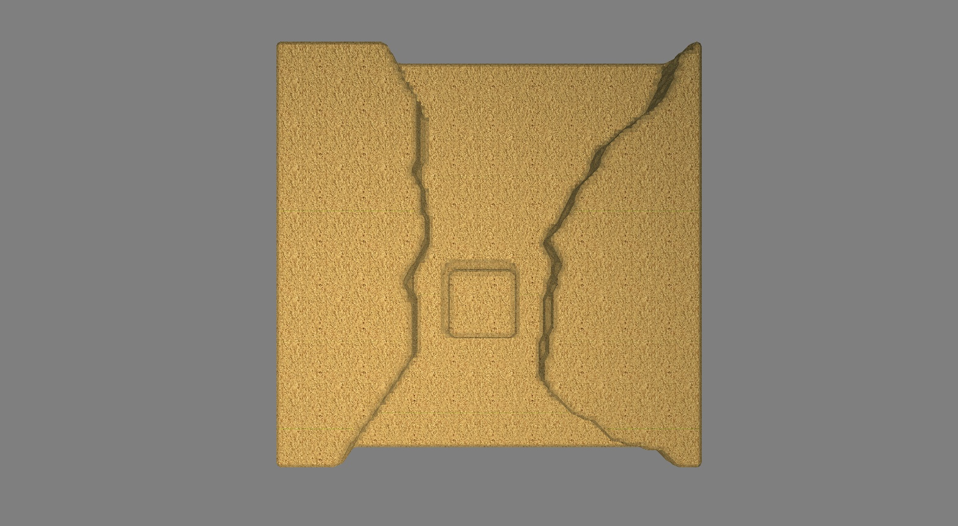
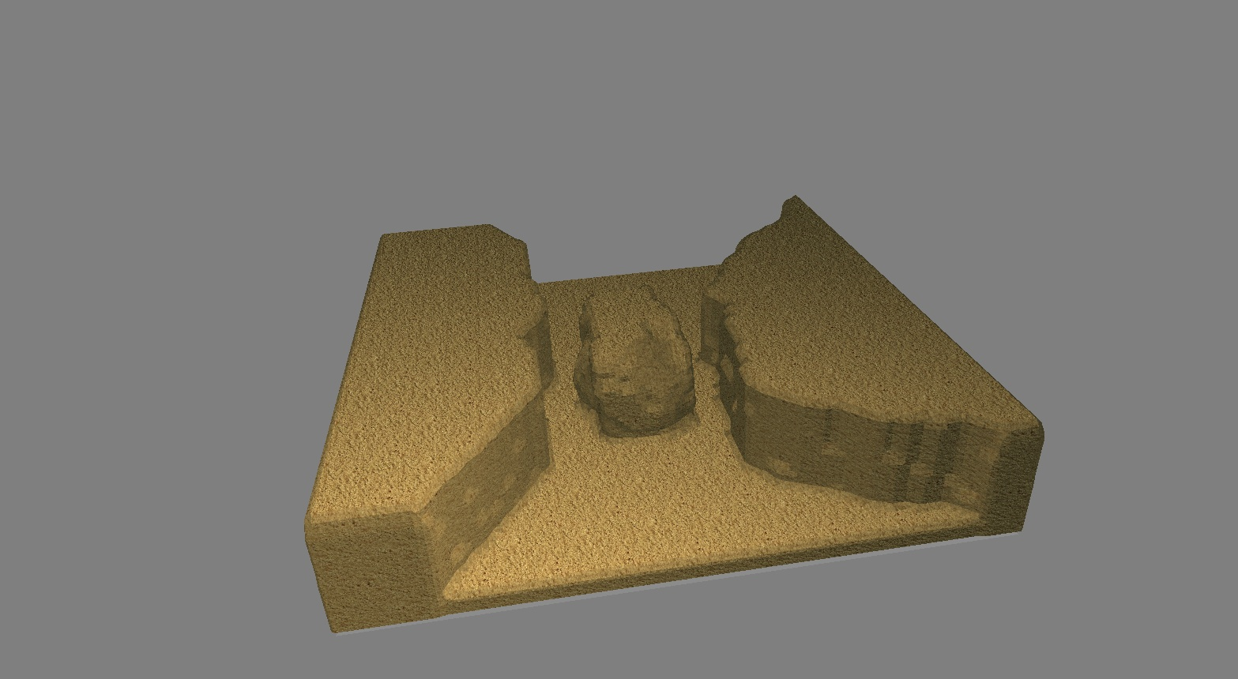

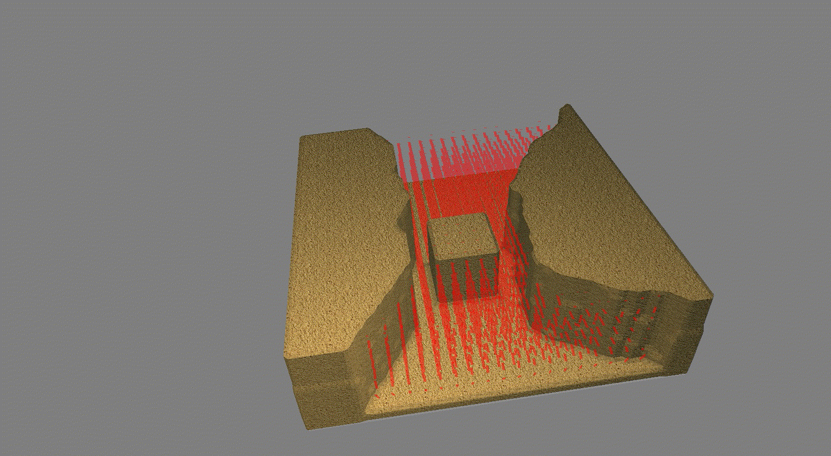


Using water currents for elements deformation
Simulate a coarse water simulation on the scene
Compute the water flow around terrain elements
Apply a deformation field

Slide 5
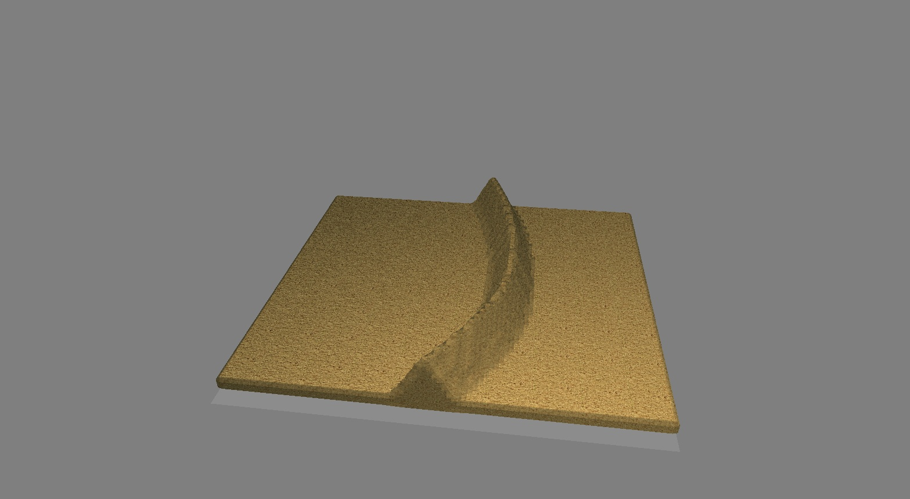
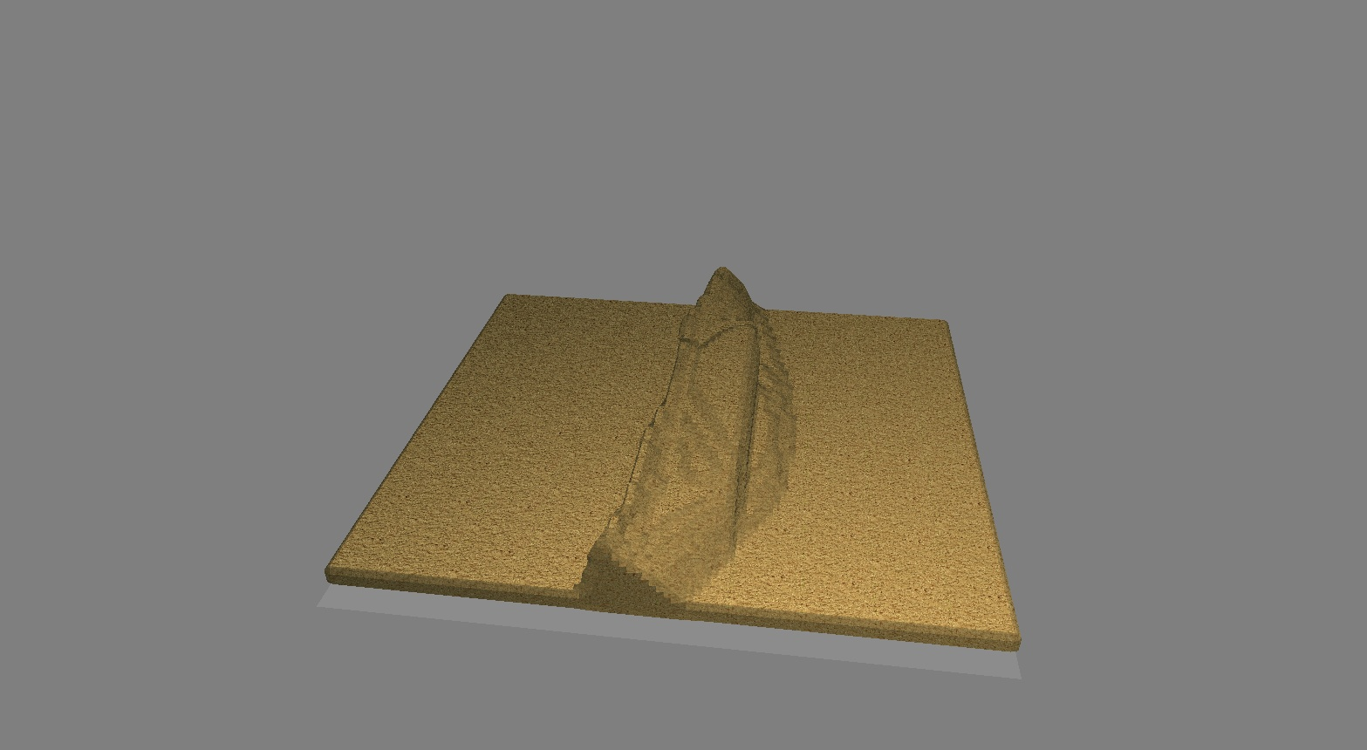
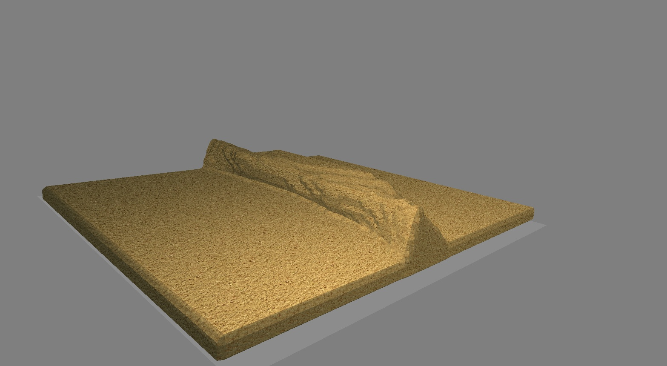
Morphing the reefs
Using exactly the same idea, deform the reef with the water current
(But it doesn’t work)

Slide 6
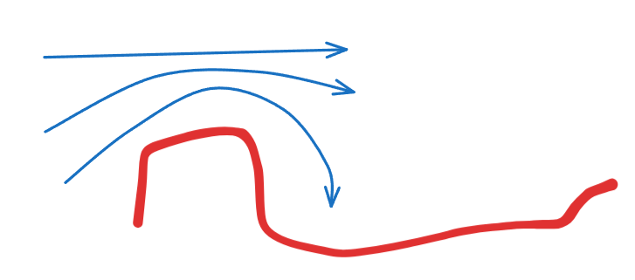
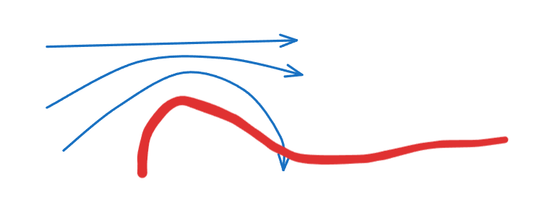
The intuition behind that

Slide 7
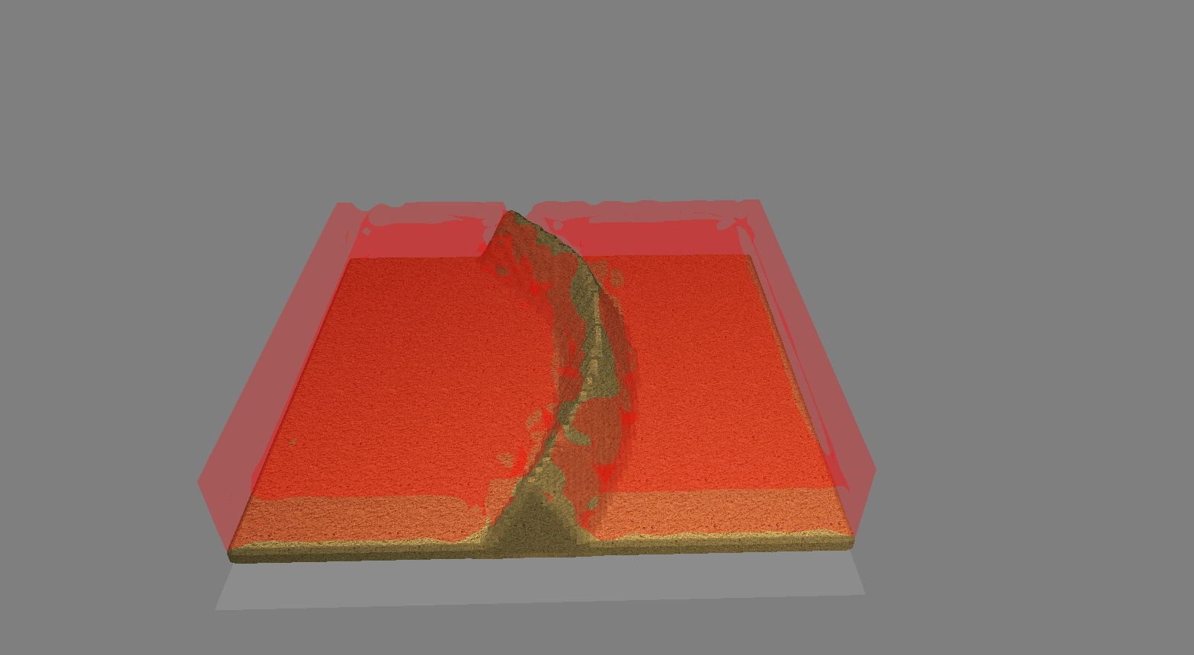
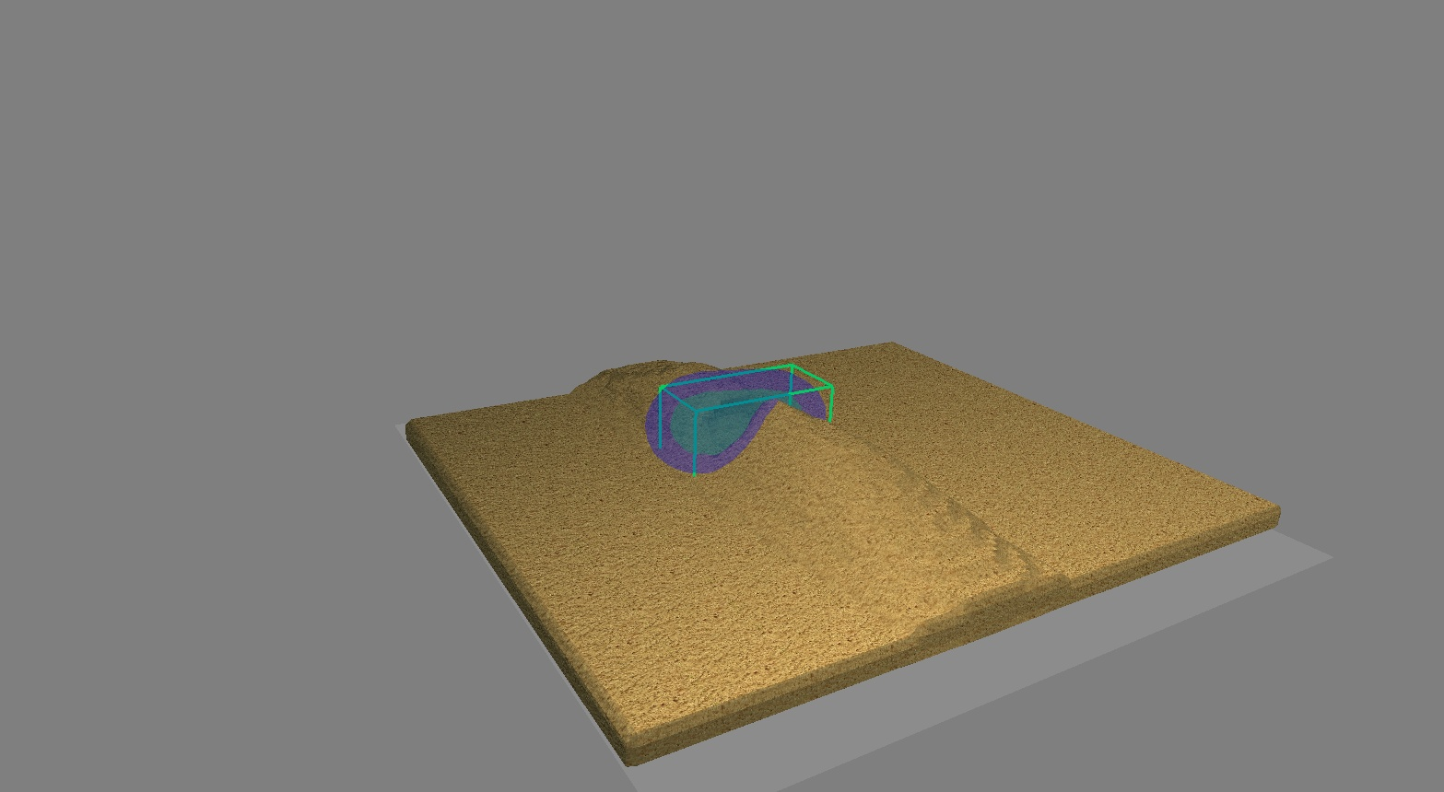
Generating passes
Simulate once again
Find «weak points» on the reef object
Compute the closest point on the other side of the reef
Dig a path between the two points

Slide 8
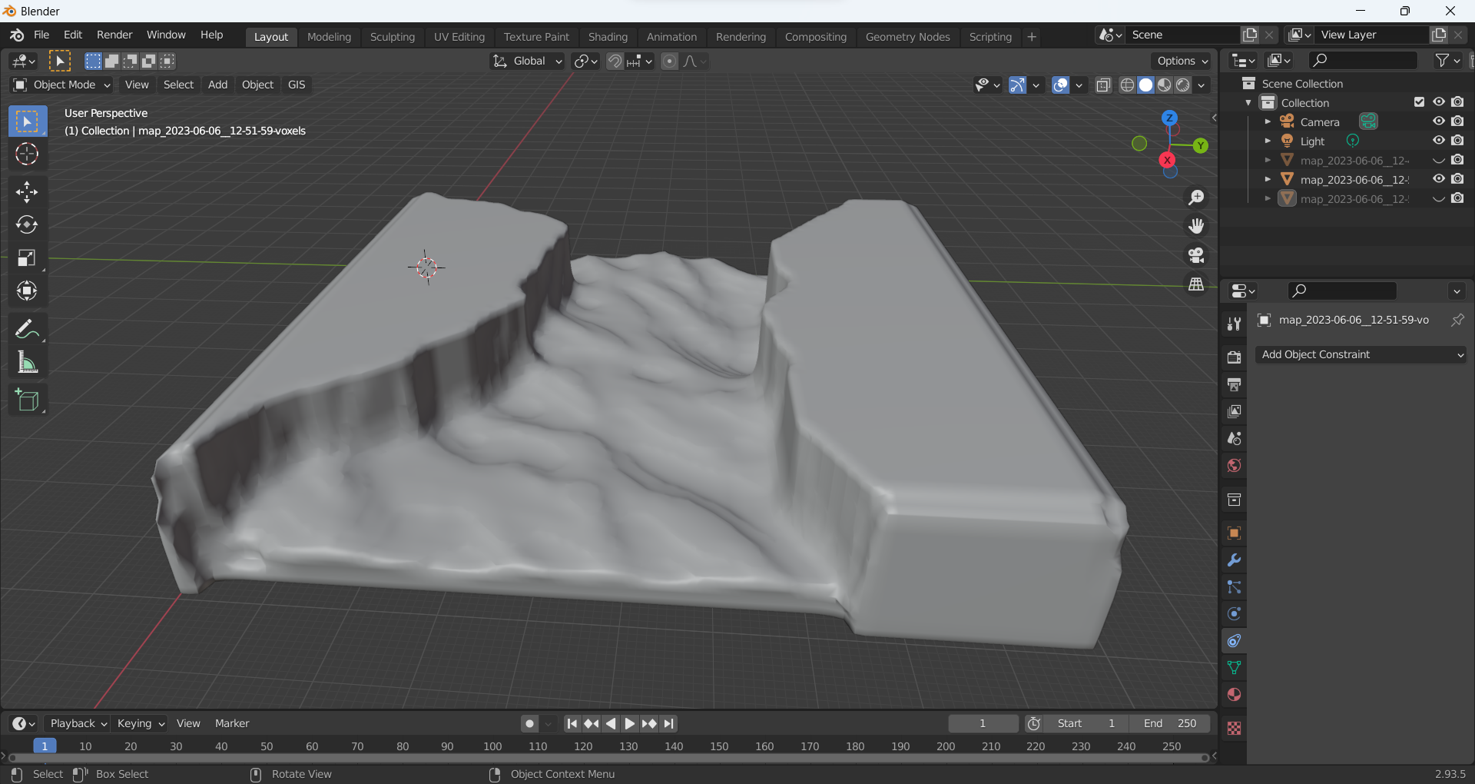
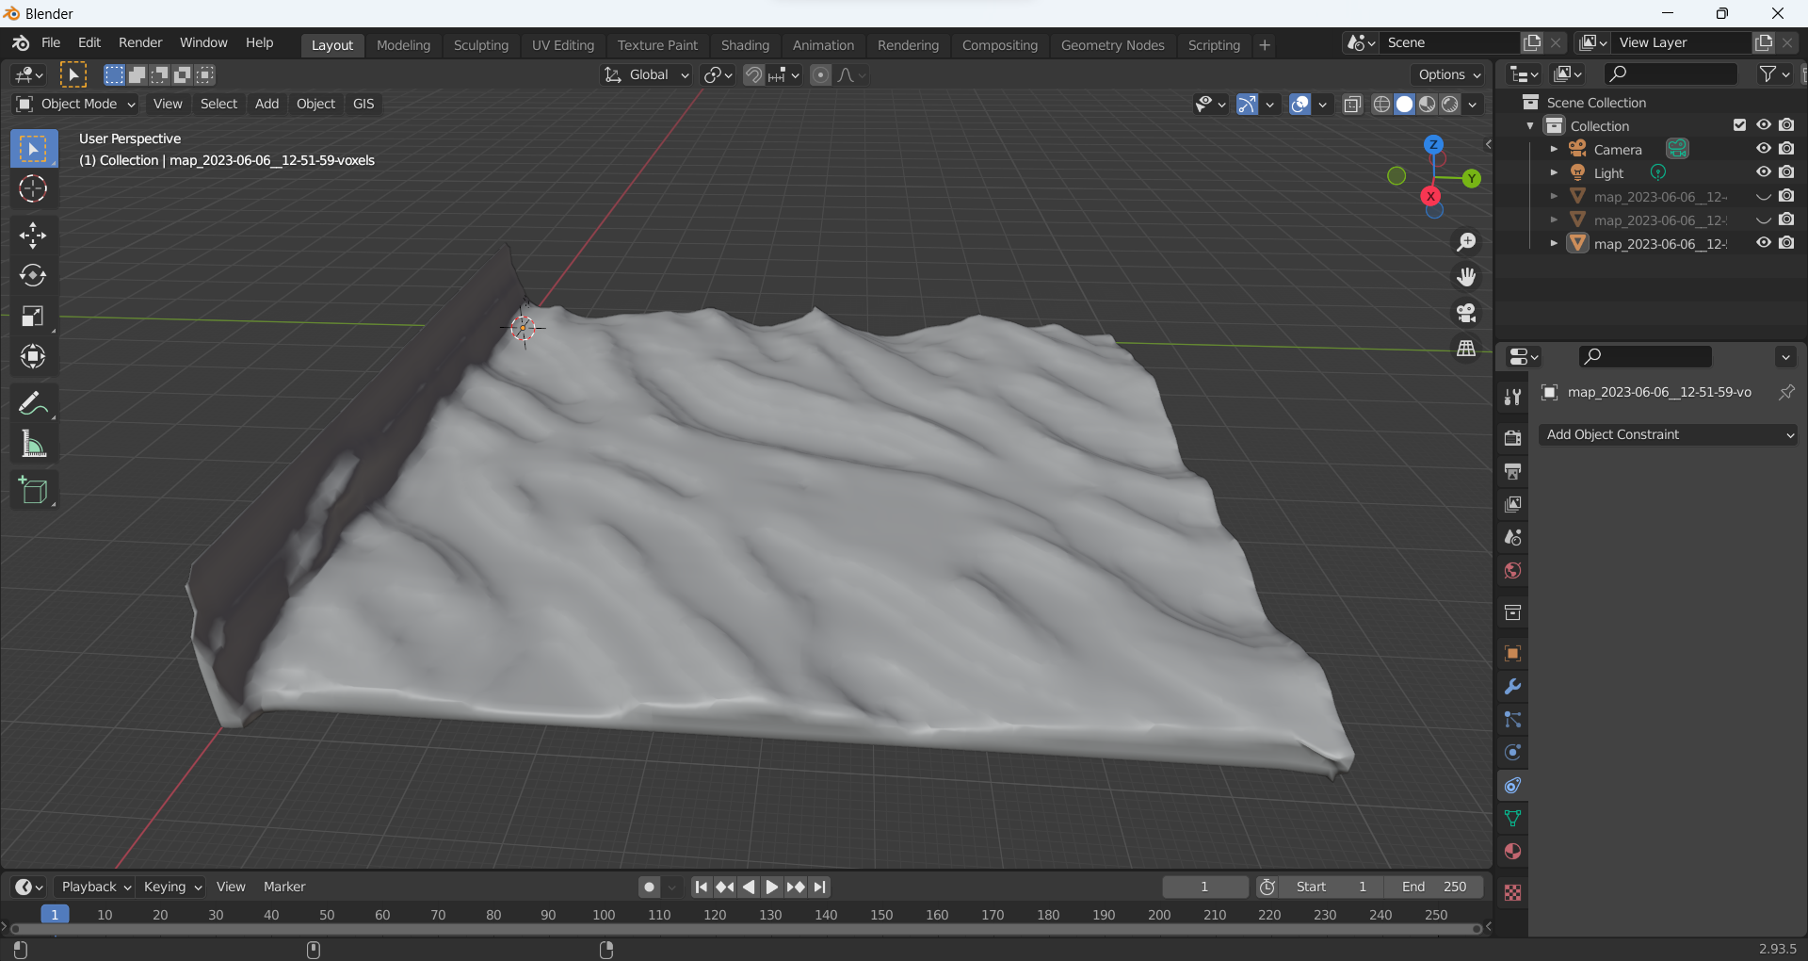
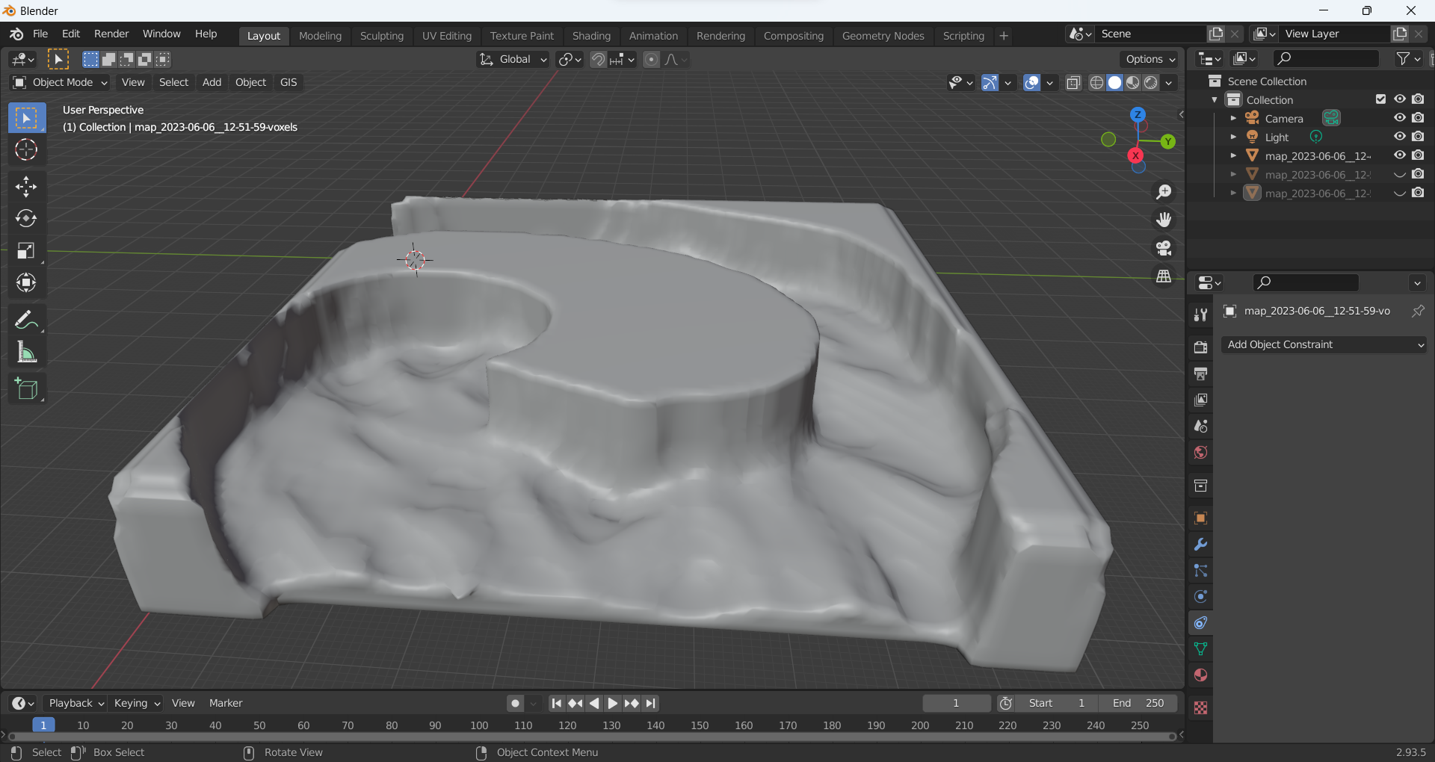
Sand ripples
Still using the same water simulation
Using a random distribution, instanciate ripple patterns on the ground
Extract the water relative speed on the ground
Rotate/rescale depending on this speed

Slide 9
So the TODO list contains :
Correction of the simulation
Compute pressure field
Try to define «weak points» and create nice passes from that
Instanciating elements depending on the current

